Slide 1

2
LIMITS AND DERIVATIVES

Slide 2
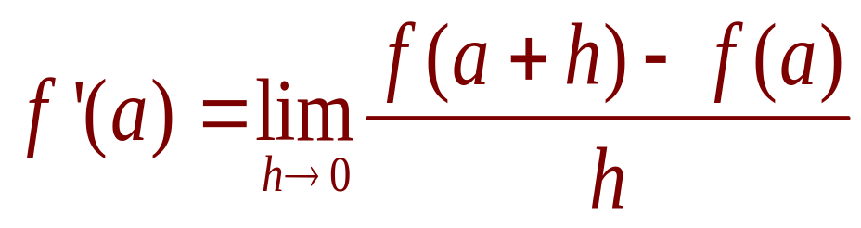
LIMITS AND DERIVATIVES
1. Equation
In Section 2.7, we considered the derivative
of a function f at a fixed number a:
In this section, we change our point of view
and let the number a vary.

Slide 3
LIMITS AND DERIVATIVES
2.8
The Derivative as a Function
In this section, we will learn about:
The derivative of a function f.

Slide 4
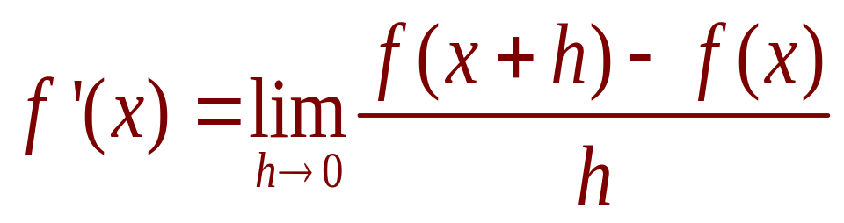
THE DERIVATIVE AS A FUNCTION
2. Equation
If we replace a in Equation 1 by
a variable x, we obtain:

Slide 5
THE DERIVATIVE AS A FUNCTION
Given any number x for which
this limit exists, we assign to x
the number f’(x).
  So, we can regard f’ as a new function—called
  the derivative of f and defined by Equation 2.
  We know that the value of f’ at x, f’(x), can be
  interpreted geometrically as the slope of the tangent
  line to the graph of f at the point (x,f(x)).

Slide 6
THE DERIVATIVE AS A FUNCTION
The function f’ is called the derivative
of f because it has been ‘derived’ from f
by the limiting operation in Equation 2.
  The domain of f’ is the set {x|f’(x) exists} and
  may be smaller than the domain of f.

Slide 7
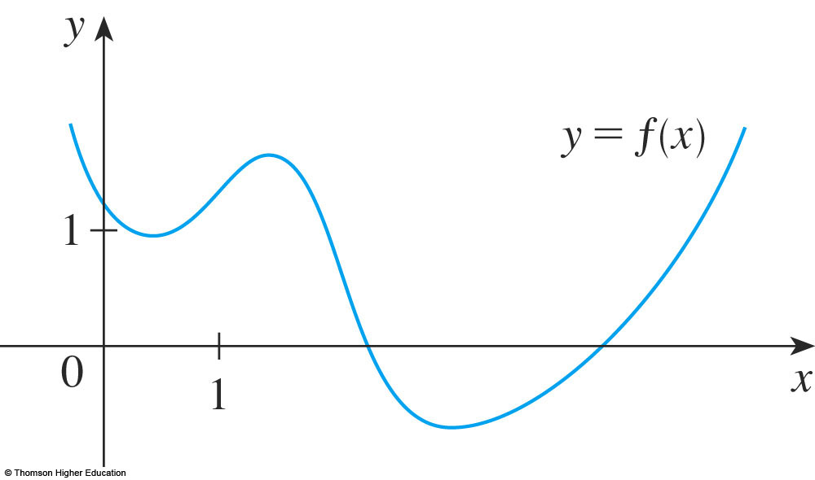
THE DERIVATIVE AS A FUNCTION
Example 1
The graph of a function f is given in
the figure.
Use it to sketch the graph of the
derivative f’.

Slide 8
THE DERIVATIVE AS A FUNCTION
Example 1
We can estimate the value of the
derivative at any value of x by drawing
the tangent at the point (x,f(x)) and
estimating its slope.

Slide 9

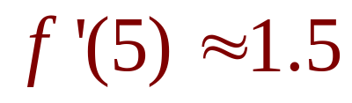
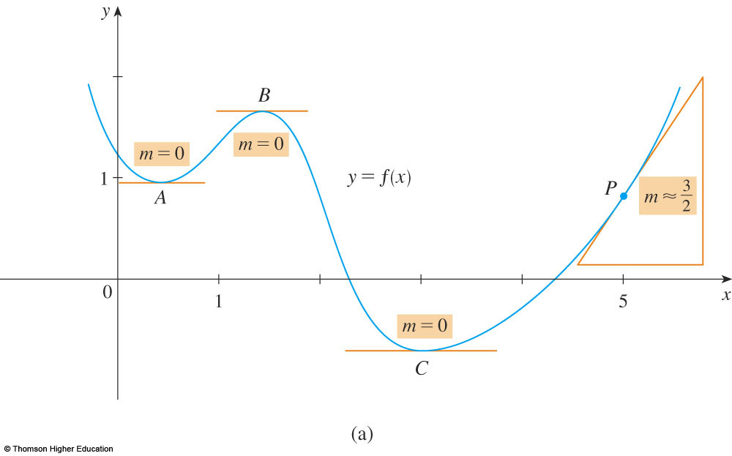
THE DERIVATIVE AS A FUNCTION
Example 1
For instance, for x = 5, we draw the
tangent at P in the figure and estimate
its slope to be about , so
  This allows us to plot the point P’(5, 1.5) on the graph
  of f’ directly beneath P.

Slide 10
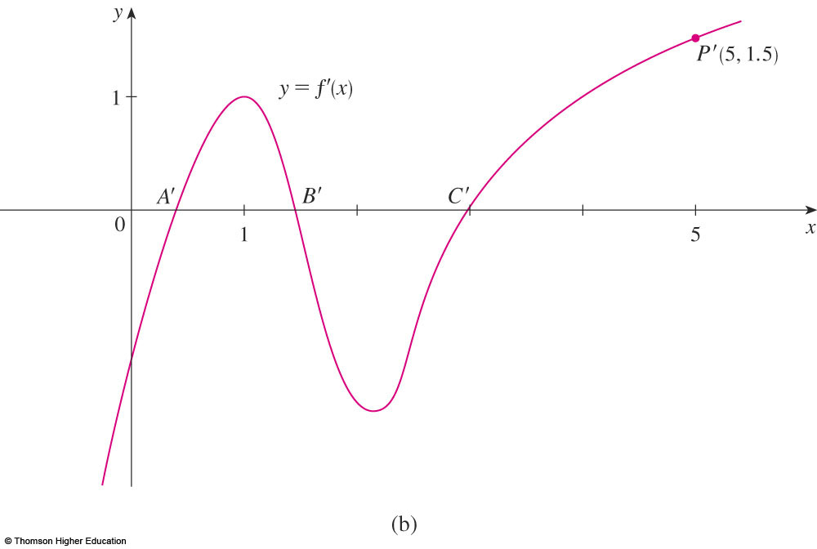
THE DERIVATIVE AS A FUNCTION
Example 1
Repeating this procedure at several
points, we get the graph shown in
this figure.

Slide 11


THE DERIVATIVE AS A FUNCTION
Example 1
Notice that the tangents at A, B, and C
are horizontal.
  So, the derivative is 0 there and the graph of f’
  crosses the x-axis at the points A’, B’, and C’,
  directly beneath A, B, and C.

Slide 12
THE DERIVATIVE AS A FUNCTION
Example 1
Between A and B, the tangents have positive
slope.
  So, f’(x) is positive there.
Between B and C, and the tangents have
negative slope.
  So, f’(x) is
  negative there.

Slide 13
THE DERIVATIVE AS A FUNCTION
Example 2
If f(x) = x³ - x, find a formula for f’(x).
Illustrate by comparing the graphs
of f and f’.

Slide 14
THE DERIVATIVE AS A FUNCTION
Example 2 a
When using Equation 2 to
compute a derivative, we must
remember that:
  The variable is h.
  x is temporarily regarded as a constant during
  the calculation of the limit.

Slide 15
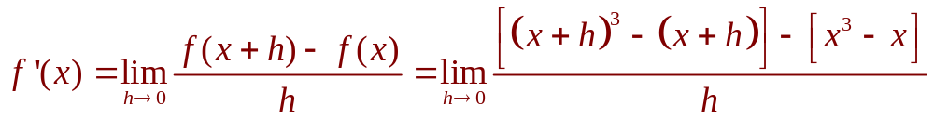
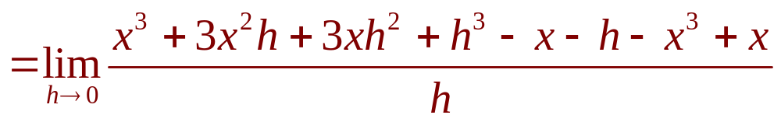
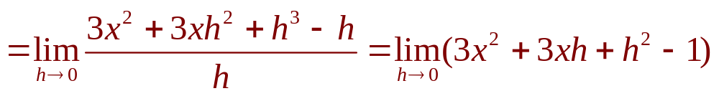

THE DERIVATIVE AS A FUNCTION
Example 2 a
Thus,

Slide 16
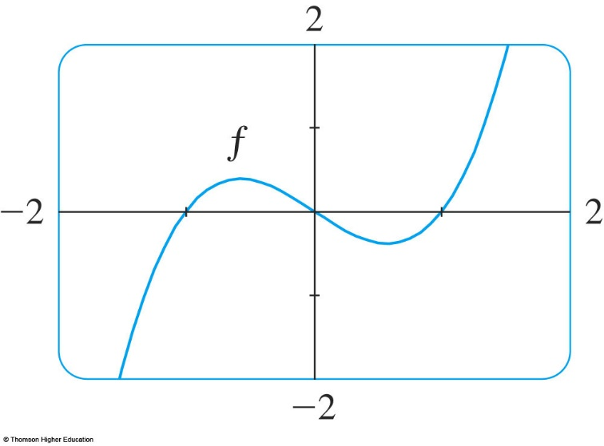
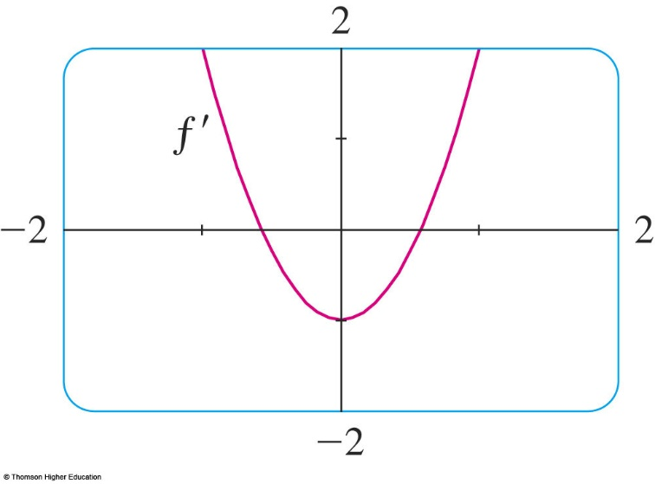
THE DERIVATIVE AS A FUNCTION
Example 2 b
We use a graphing device to graph f
and f’ in the figure.
  Notice that f’(x) = 0 when f has horizontal tangents and f’(x) is positive when the tangents have positive slope.
  So, these graphs serve as a check on our work in
  part (a).

Slide 17
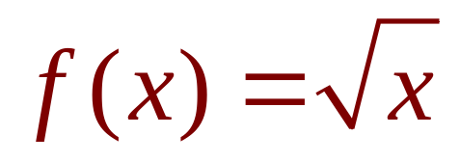
THE DERIVATIVE AS A FUNCTION
Example 3
If , find the derivative
of f.
State the domain of f’.

Slide 18
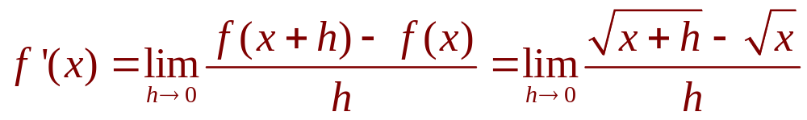
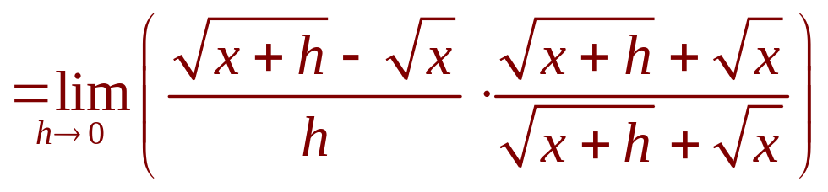
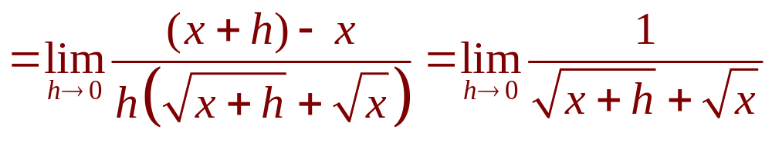
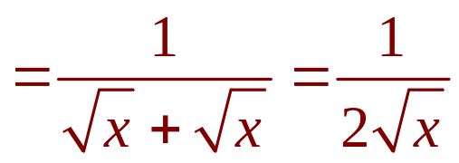

THE DERIVATIVE AS A FUNCTION
Example 3
  We see that f’(x) exists if x > 0, so the domain of f’ is
  This is smaller than the domain of f, which is

Slide 19
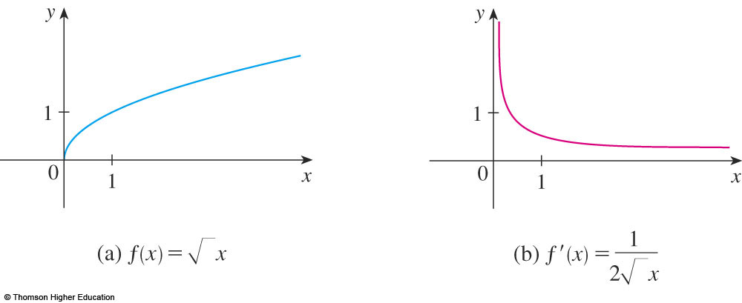
THE DERIVATIVE AS A FUNCTION
Let’s check to see that the result of
Example 3 is reasonable by looking
at the graphs of f and f’ in the figure.

Slide 20
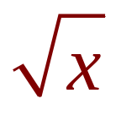
THE DERIVATIVE AS A FUNCTION
When x is close to 0, is also close
to 0.
So, f’(x) = 1/(2 ) is very large.
  This corresponds to the steep tangent lines near (0,0)
  in (a) and the large values of f’(x) just to the right of 0
  in (b).

Slide 21
THE DERIVATIVE AS A FUNCTION
When x is large, f’(x) is very
small.
  This corresponds to the flatter tangent lines at the far right of the graph of f and the horizontal asymptote of
  the graph of f’.

Slide 22
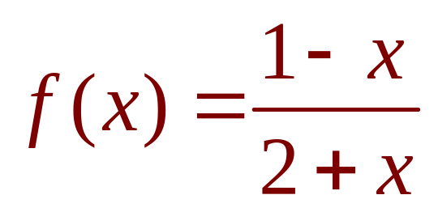
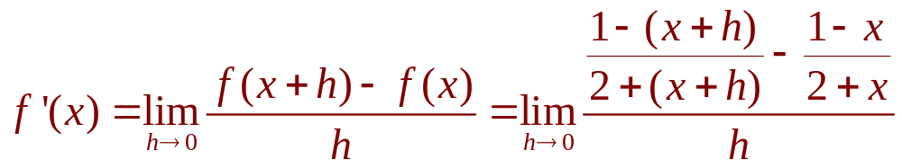
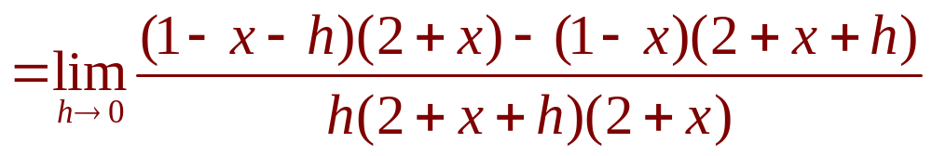
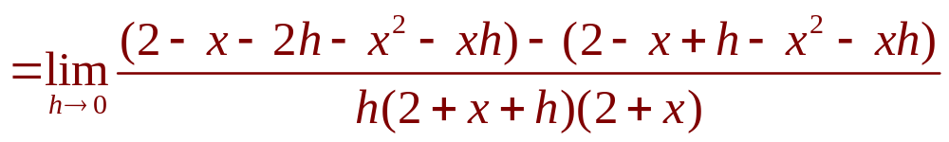
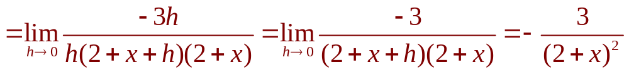
THE DERIVATIVE AS A FUNCTION
Example 4
Find f’ if

Slide 23
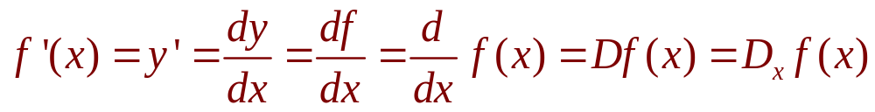
OTHER NOTATIONS
If we use the traditional notation y = f(x)
to indicate that the independent variable is x
and the dependent variable is y, then some
common alternative notations for the
derivative are as follows:

Slide 24
OTHER NOTATIONS
The symbols D and d/dx are
called differentiation operators.
  This is because they indicate the operation of differentiation, which is the process of calculating
  a derivative.

Slide 25
OTHER NOTATIONS
The symbol dy/dx—which was introduced
by Leibniz—should not be regarded as
a ratio (for the time being).
  It is simply a synonym for f’(x).
  Nonetheless, it is very useful and suggestive—especially when used in conjunction with increment notation.

Slide 26
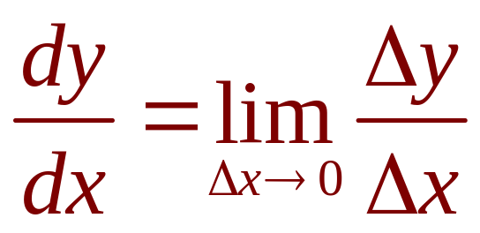
OTHER NOTATIONS
Referring to Equation 6 in Section 2.7,
we can rewrite the definition of derivative
in Leibniz notation in the form

Slide 27
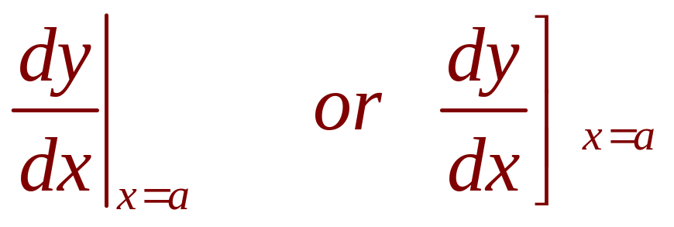
OTHER NOTATIONS
If we want to indicate the value of a derivative
dy/dx in Leibniz notation at a specific number
a, we use the notation
which is a synonym for f’(a).

Slide 28

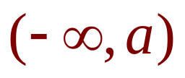

OTHER NOTATIONS
3. Definition
A function f is differentiable at a if f’(a) exists.
It is differentiable on an open interval (a,b)
[or or or ] if it is
differentiable at every number in the interval.

Slide 29
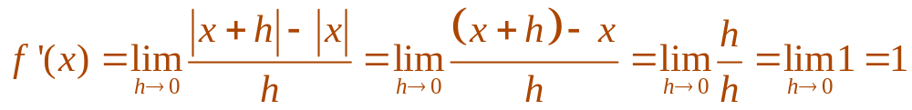
OTHER NOTATIONS
Example 5
Where is the function f(x) = |x|
differentiable?
  If x > 0, then |x| = x and we can choose h small enough that x + h > 0 and hence |x + h| = x + h.
  Therefore, for x > 0, we have:
  So, f is differentiable for any x > 0.

Slide 30
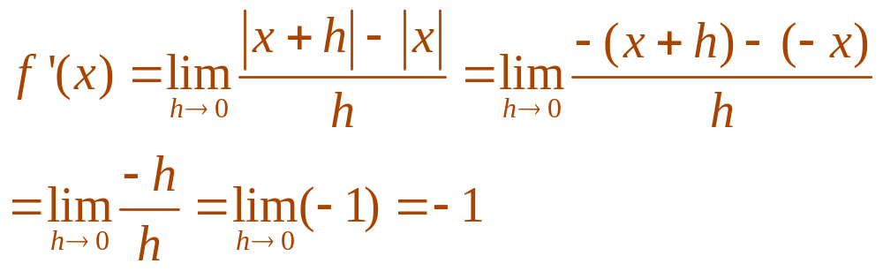
OTHER NOTATIONS
Example 5
  Similarly, for x < 0, we have |x| = -x and h can
  be chosen small enough that x + h < 0 and so
  |x + h| = -(x + h).
  Therefore, for x < 0,
  So, f is differentiable for any x < 0.

Slide 31
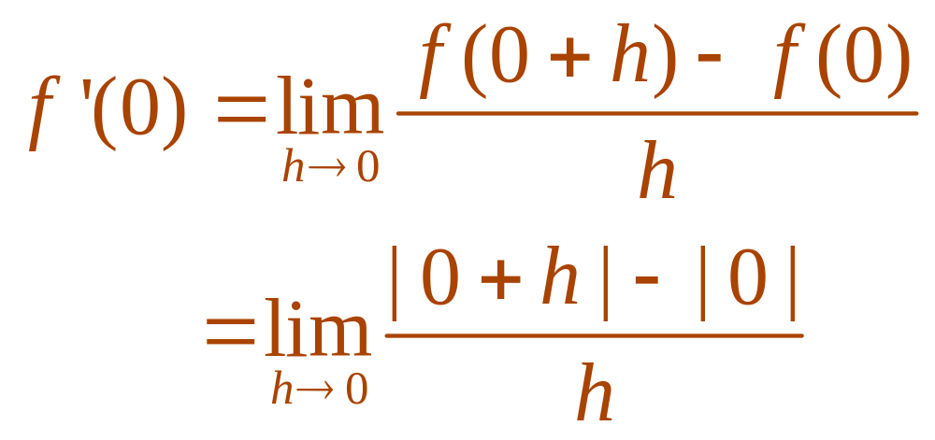
OTHER NOTATIONS
Example 5
  For x = 0, we have to investigate
  (if it exists)

Slide 32
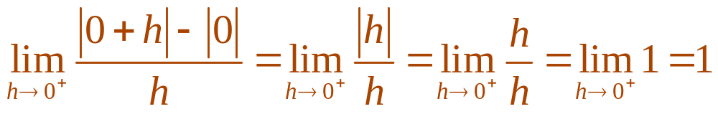
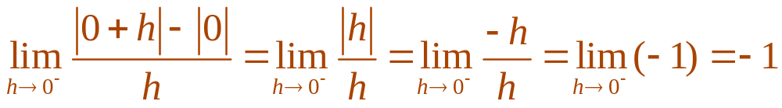
OTHER NOTATIONS
Example 5
  Let’s compute the left and right limits separately:
  and
  Since these limits are different, f’(0) does not exist.
  Thus, f is differentiable at all x except 0.

Slide 33
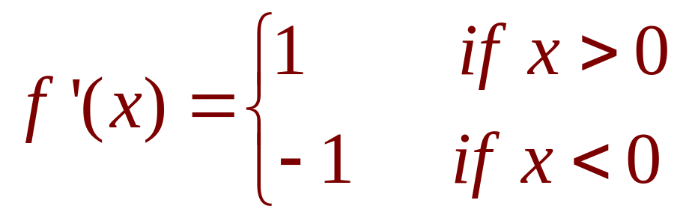
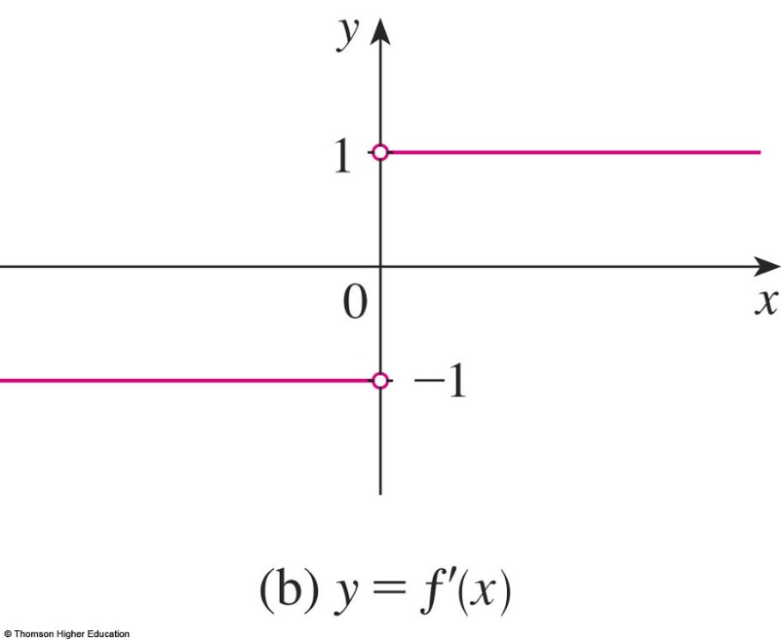
OTHER NOTATIONS
Example 5
A formula for f’ is given by:
Its graph is shown in the figure.

Slide 34
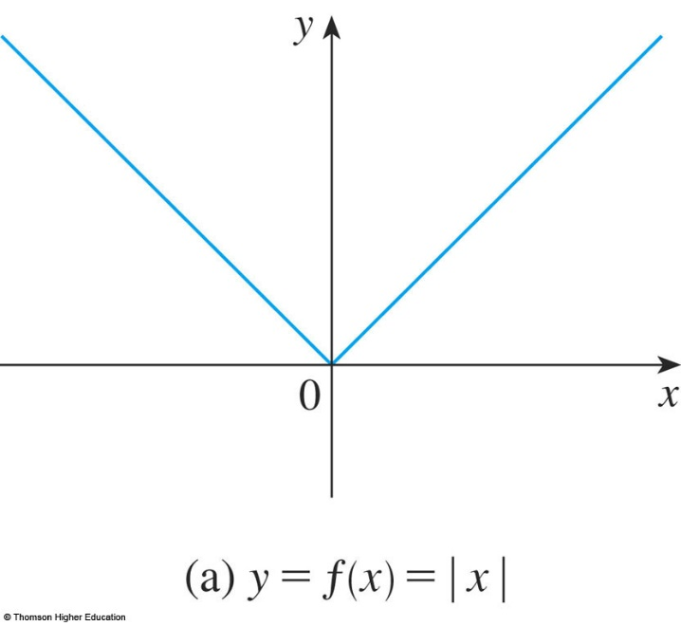
OTHER NOTATIONS
The fact that f’(0) does not exist
is reflected geometrically in the fact
that the curve y = |x| does not have
a tangent line at (0, 0).

Slide 35
OTHER NOTATIONS
Both continuity and differentiability
are desirable properties for a function
to have.
  The following theorem shows how these
  properties are related.

Slide 36
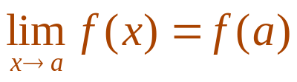
OTHER NOTATIONS
4. Theorem
If f is differentiable at a, then
f is continuous at a.
  To prove that f is continuous at a, we have to show
  that .
  We do this by showing that the difference f(x) - f(a) approaches 0.

Slide 37
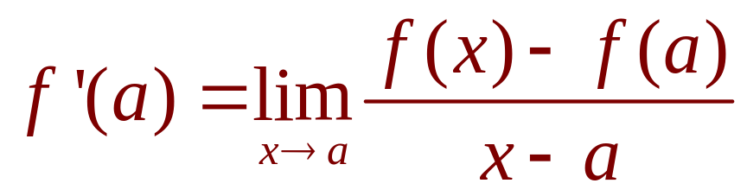
OTHER NOTATIONS
Proof
The given information is that f is
differentiable at a.
That is, exists.
  See Equation 5 in Section 2.7.

Slide 38
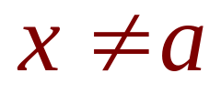
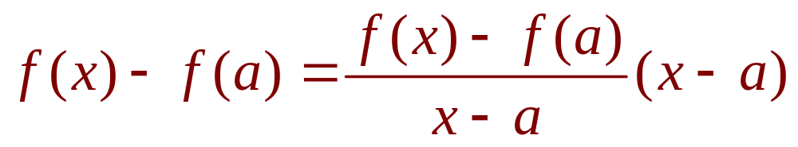
OTHER NOTATIONS
Proof
To connect the given and the unknown,
we divide and multiply f(x) - f(a) by x - a
(which we can do when ):

Slide 39
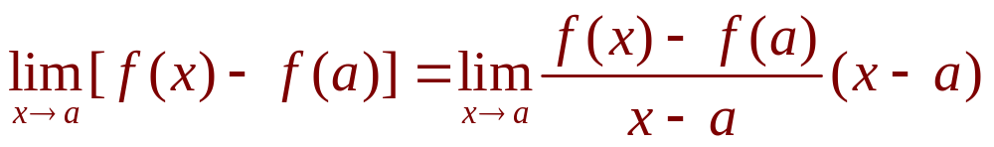
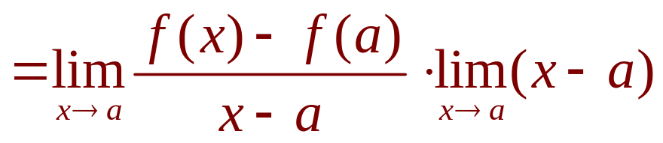
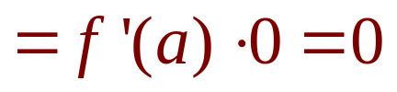
OTHER NOTATIONS
Proof
Thus, using the Product Law and
Equation 5 in Section 2.7, we can write:

Slide 40
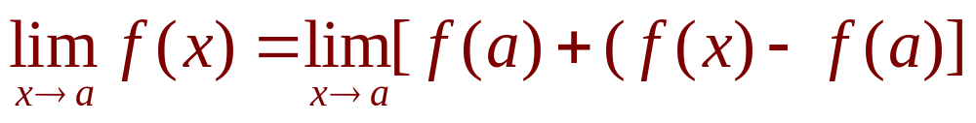
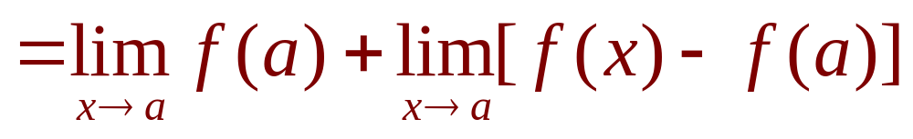
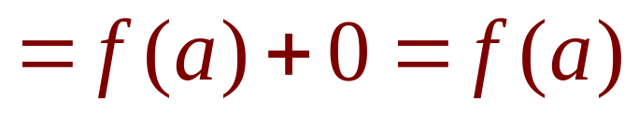
OTHER NOTATIONS
Proof
To use what we have just proved, we
start with f(x) and add and subtract f(a):
  Therefore, f is continuous at a.

Slide 41
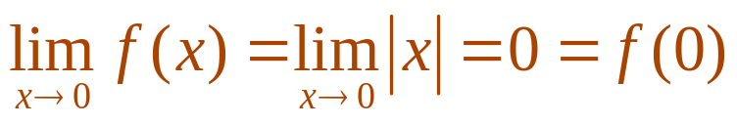
OTHER NOTATIONS
Note
The converse of Theorem 4 is false.
That is, there are functions that are
continuous but not differentiable.
  For instance, the function f(x) = |x| is continuous
  at 0 because
  See Example 7 in Section 2.3.
  However, in Example 5, we showed that f is not differentiable at 0.

Slide 42
HOW CAN A FUNCTION FAIL TO BE DIFFERENTIABLE?
We saw that the function y = |x| in
Example 5 is not differentiable at 0 and
the figure shows that its graph changes
direction abruptly when x = 0.

Slide 43
HOW CAN A FUNCTION FAIL TO BE DIFFERENTIABLE?
In general, if the graph of a function f has
a ‘corner’ or ‘kink’ in it, then the graph of f
has no tangent at this point and f is not
differentiable there.
  In trying to compute f’(a), we find that the left and
  right limits are different.

Slide 44
HOW CAN A FUNCTION FAIL TO BE DIFFERENTIABLE?
Theorem 4 gives another
way for a function not to have
a derivative.
  It states that, if f is not continuous at a, then f
  is not differentiable at a.
  So, at any discontinuity—for instance, a jump discontinuity—f fails to be differentiable.

Slide 45
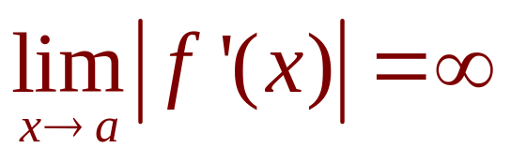
HOW CAN A FUNCTION FAIL TO BE DIFFERENTIABLE?
A third possibility is that the curve has
a vertical tangent line when x = a.
That is, f is continuous at a and

Slide 46

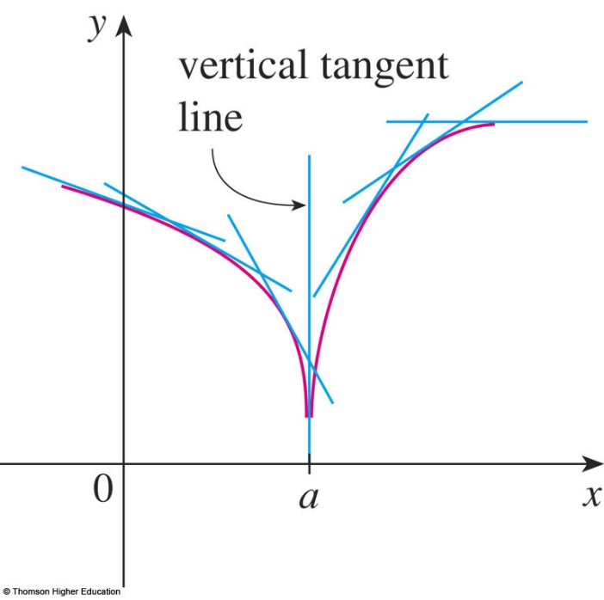
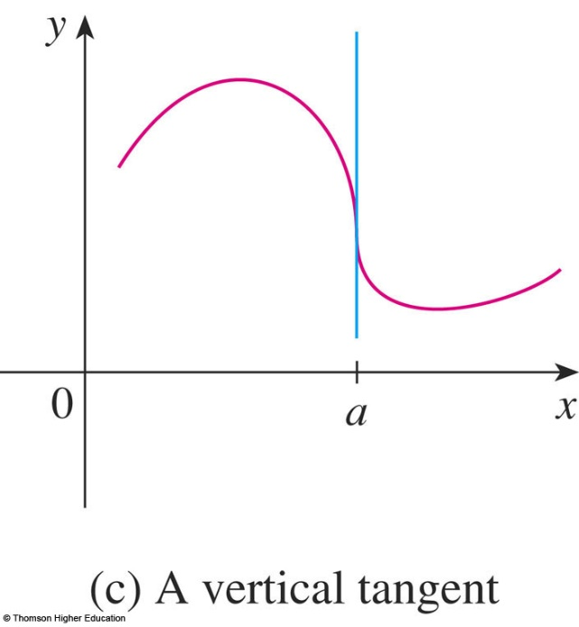
HOW CAN A FUNCTION FAIL TO BE DIFFERENTIABLE?
This means that the tangent lines
become steeper and steeper as .
  The figures show two different ways that this can happen.

Slide 47
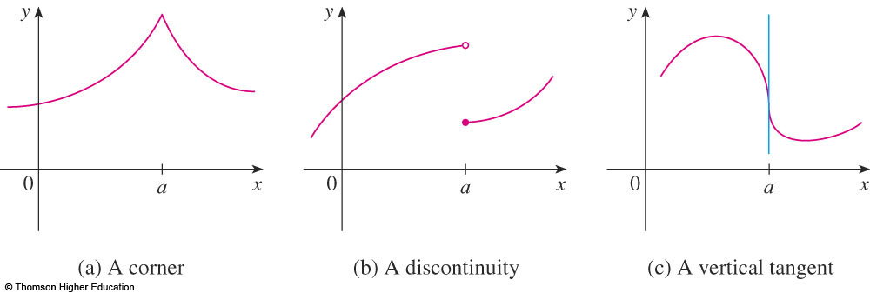
HOW CAN A FUNCTION FAIL TO BE DIFFERENTIABLE?
The figure illustrates the three
possibilities we have discussed.

Slide 48

HOW CAN A FUNCTION FAIL TO BE DIFFERENTIABLE?
A graphing calculator or computer
provides another way of looking at
differentiability.
  If f is differentiable at a, then when we zoom in toward the point (a,f(a)), the graph straightens out and appears more and more like a line.
  We saw a specific
  example of this in
  Figure 2 in Section 2.7.

Slide 49



HOW CAN A FUNCTION FAIL TO BE DIFFERENTIABLE?
However, no matter how much we zoom in
toward a point like the ones in the first two
figures, we can’t eliminate the sharp point or
corner, as in the third figure.

Slide 50
HIGHER DERIVATIVES
If f is a differentiable function, then its
derivative f’ is also a function.
So, f’ may have a derivative of its own,
denoted by (f’)’= f’’.

Slide 51

HIGHER DERIVATIVES
This new function f’’ is called
the second derivative of f.
  This is because it is the derivative of the derivative
  of f.
  Using Leibniz notation, we write the second derivative
  of y = f(x) as

Slide 52



HIGHER DERIVATIVES
Example 6
If , find and
interpret f’’(x).
  In Example 2, we found that the first derivative
  is .
  So the second derivative is:

Slide 53

HIGHER DERIVATIVES
Example 6
The graphs of f, f’, f’’ are shown in
the figure.
  We can interpret f’’(x) as the slope of the curve y = f’(x) at the point (x,f’(x)).
  In other words, it is the rate of change of the slope of
  the original curve y = f(x).

Slide 54
HIGHER DERIVATIVES
Example 6
Notice from the figure that f’’(x) is negative
when y = f’(x) has negative slope and positive
when y = f’(x) has positive slope.
  So, the graphs serve as a check on our calculations.

Slide 55
HIGHER DERIVATIVES
In general, we can interpret a second
derivative as a rate of change of a rate
of change.
  The most familiar example of this is acceleration,
  which we define as follows.

Slide 56

HIGHER DERIVATIVES
If s = s(t) is the position function of an object
that moves in a straight line, we know that
its first derivative represents the velocity v(t)
of the object as a function of time:

Slide 57


HIGHER DERIVATIVES
The instantaneous rate of change
of velocity with respect to time is called
the acceleration a(t) of the object.
  Thus, the acceleration function is the derivative of
  the velocity function and is, therefore, the second
  derivative of the position function:
  In Leibniz notation, it is:

Slide 58

HIGHER DERIVATIVES
The third derivative f’’’ is the derivative
of the second derivative: f’’’ = (f’’)’.
  So, f’’’(x) can be interpreted as the slope of the curve
  y = f’’(x) or as the rate of change of f’’(x).
  If y = f(x), then alternative notations for the third derivative are:

Slide 59

HIGHER DERIVATIVES
The process can be continued.
  The fourth derivative f’’’’ is usually denoted by f⁽⁴⁾.
  In general, the nth derivative of f is denoted by f^{(n)}
  and is obtained from f by differentiating n times.
  If y = f(x), we write:

Slide 60
HIGHER DERIVATIVES
Example 7
If , find f’’’(x) and
f⁽⁴⁾(x).
  In Example 6, we found that f’’(x) = 6x.
  The graph of the second derivative has equation y = 6x.
  So, it is a straight line with slope 6.

Slide 61
HIGHER DERIVATIVES
Example 7
  Since the derivative f’’’(x) is the slope of f’’(x),
  we have f’’’(x) = 6 for all values of x.
  So, f’’’ is a constant function and its graph is
  a horizontal line.
  Therefore, for all values of x, f ⁽⁴⁾ (x) = 0

Slide 62

HIGHER DERIVATIVES
We can interpret the third derivative physically
in the case where the function is the position
function s = s(t) of an object that moves along
a straight line.
  As s’’’ = (s’’)’ = a’, the third derivative of the position function is the derivative of the acceleration function.
  It is called the jerk/jolt.

Slide 63
HIGHER DERIVATIVES
Thus, the jerk j is the rate of
change of acceleration.
  It is aptly named because a large jerk means
  a sudden change in acceleration, which causes
  an abrupt movement in a vehicle.

Slide 64
HIGHER DERIVATIVES
We have seen that one application
of second and third derivatives occurs
in analyzing the motion of objects using
acceleration and jerk.

Slide 65
HIGHER DERIVATIVES
We will investigate another
application of second derivatives
in Section 4.3.
  There, we show how knowledge of f’’ gives us information about the shape of the graph of f.

Slide 66
HIGHER DERIVATIVES
In Chapter 11, we will see how
second and higher derivatives enable
us to represent functions as sums
of infinite series.

